Slide 1

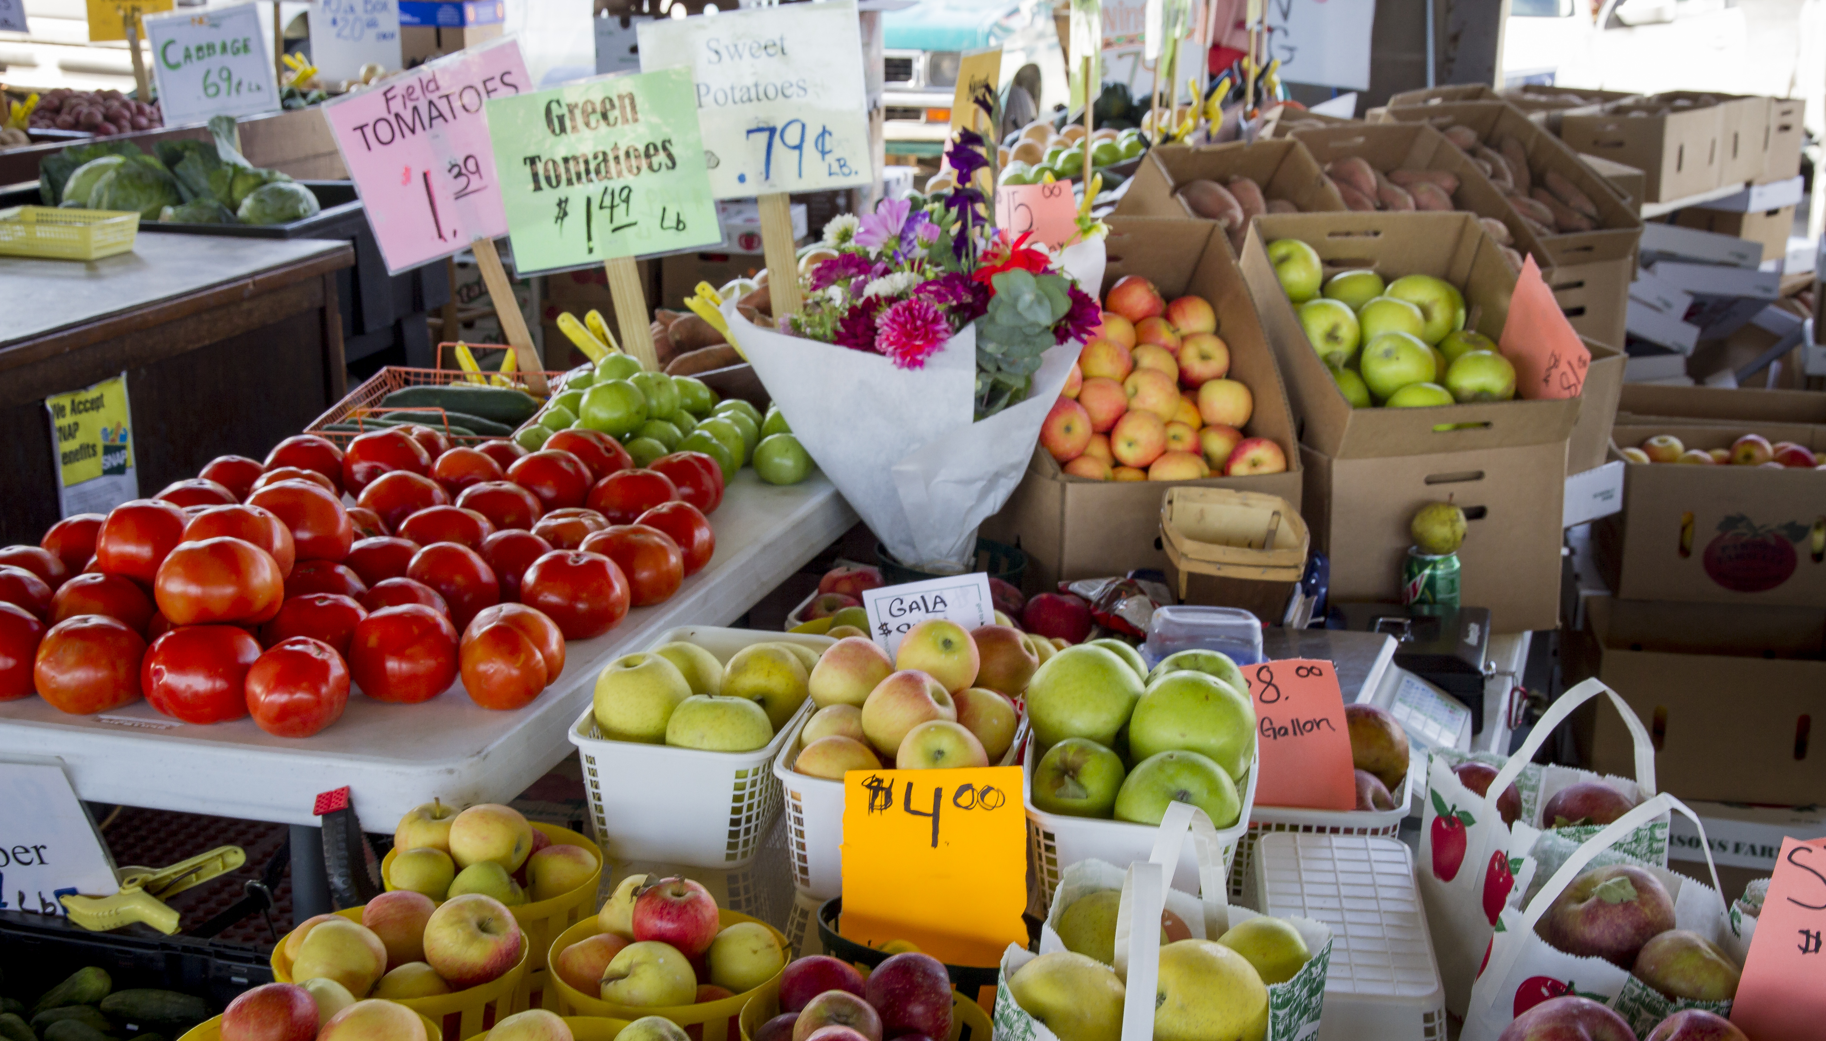
Association Rules
Luis Miralles

Slide 2
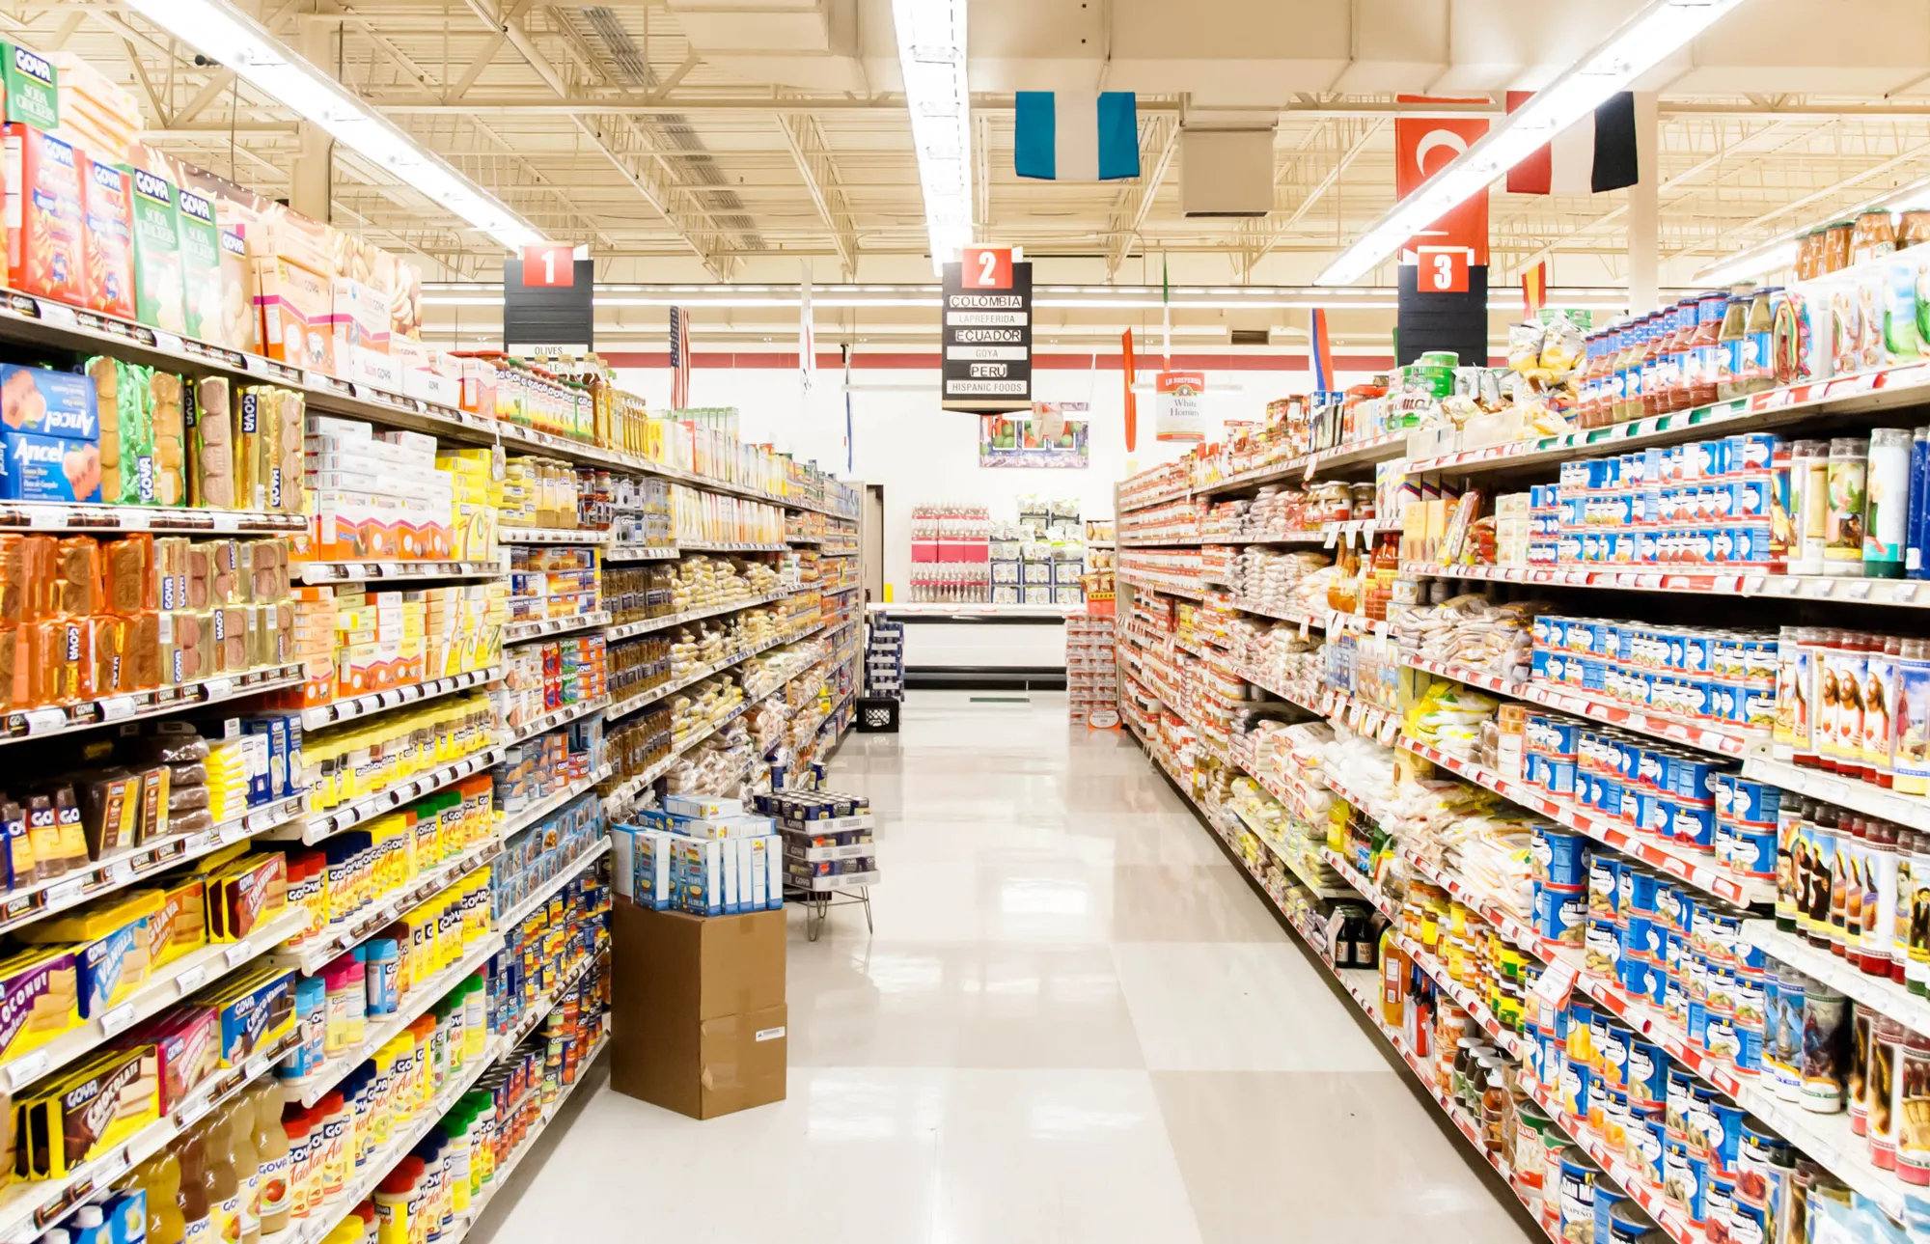
How often do you end up buying more items than you were expecting?

Slide 3
Structure of the class
Review of time series of the previous class
Orange DM applied to Time Series.
Introduction to Association Rules
Orange data mining exercises for Association Rules
Text mining and Image classification
Orange data mining exercises for Text Mining and Images
Showcase of Time Series Class and Clustering

Slide 4
Learning outcomes
Learn the concept of Time Series and clustering applied to TS
Learn what Time series similarity measures are
Predict future points using ARIMA
Introducing the concept of association rules and basket analysis
Getting familiar with Orange DM
Introduction to Natural Language Processing and Text Mining
Introduction to Image Classification

Slide 5

Section 1 Association rules

Slide 6
Apriori Algorithm in Machine Learning: Discovering rules
A rule tells you associations between the items of the rule.
When a dataset contains millions of transactions, tools are needed to identify the most important relationships.
The Apriori algorithm, developed by R. Agrawal and Srikant in 1994, is well-known for detecting this association.
Big companies use finding these patterns to increase their sales. Think of Amazon, Google with its ads, Google News, Podcasts, etc.

Slide 7
Association rules
Association rules help find relationships and patterns in large datasets containing multiple transactions, each comprising one or more items.
The idea here is to find frequent patterns, which can be very helpful for improving the business.
Association rules are used for the typical case of market-based analysis, a.k.a. Transaction data.
It is usually applied to retail but can also be used in many other domains, such as medicine, tourism, etc.
https://www.youtube.com/watch?v=ahPMlCe3WII&ab_channel=HussamHourani

Slide 8
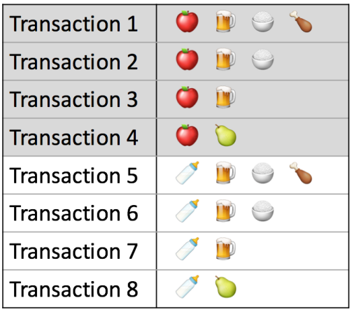

Main metrics in data mining
Imagine the following rule:
“If the basket contains apples, it will also contain beer.”
Antecedent
Consequent
The main measures are support, confidence, and lift.
Measure 1—Support: It indicates how popular an item is in the dataset and is calculated as the proportion in which it appears. This represents how often the "If" statement is true. If there are 20 transactions and 10 of these contain bread and butter, the coverage is 10/20.
Good explanation here:
https://www.kdnuggets.com/2016/04/association-rules-apriori-algorithm-tutorial.html

Slide 9

Main metrics in data mining
Imagine the following rule:
“If the basket contains apples, it will also contain beer.”
Measure 2- Confidence: This represents how often this rule is true. For example, if there are 4 transactions that contain apples and 3 contain beer. We will say that the confidence is 3/4.

Slide 10

Main metrics in data mining
Imagine the following rule:
“If the basket contains apples, it will also contain beer.”
Measure 3- Lift: Lift measures how strong the relationship between two items is. It compares how likely two items are to be bought together with the probability you would expect if they had no relationship.
In other words, it compares the likelihood that apples and beer appear together with the probability that apples and beer are independent. Higher than one means they have a strong relationship.
https://hands-on.cloud/implementation-of-apriori-algorithm-using-python/#lift

Slide 11
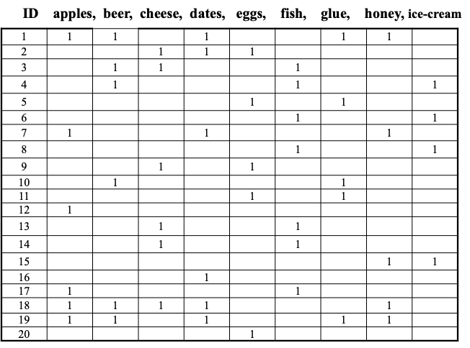
ID. orange, coke, mayo, milk, meat, crisps, corn, butter, bread

Slide 12
Apriori algorithm for finding large item sets
1 Find all large 1-itemsets
2 For (k = 2 ; while L_{k-1} is non-empty; k++)
3 {C_{k} = apriori-gen(L_{k-1})
4 For each c in C_{k}, initialise c.count to zero
For all records r in the DB
{C_{r} = subset(C_{k}, r); For each c in C_{r} , c.count++ }
7 Set L_{k} := all c in C_{k} whose count >= minsup
8 } /* end -- return all of the L_{k} sets.

Slide 13
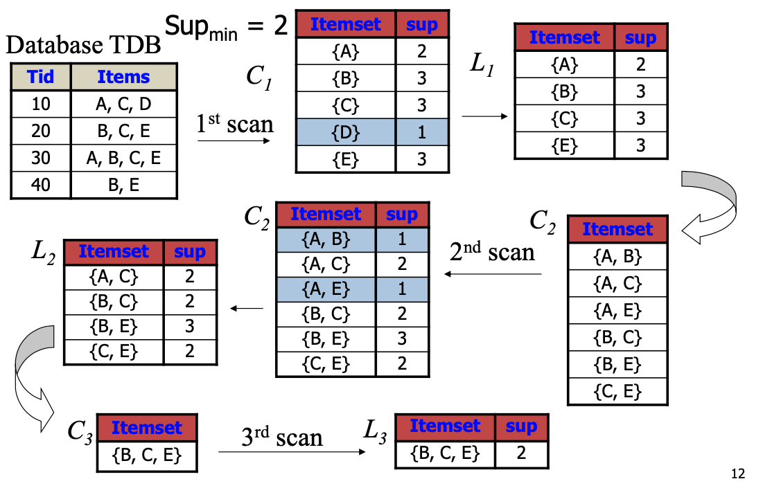

Slide 14
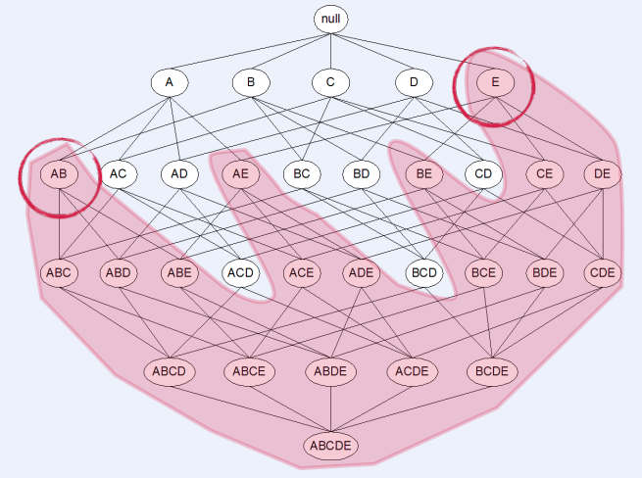
If E and AB are infrequent, then we can remove all the rules that have them.
Apriori pruning principle: If an itemset is infrequent, then its superset is also infrequent and therefore we do not need to calculate its support. In other words, if {X} is infrequent, then any combination of {X} with any other item/s like {X,Y} will also be infrequent.
Chapter 4: Frequent Itemsets and Association Rules
IRDM ‘15/16 . 3 Nov 2015 . Jilles Vreeken

Slide 15
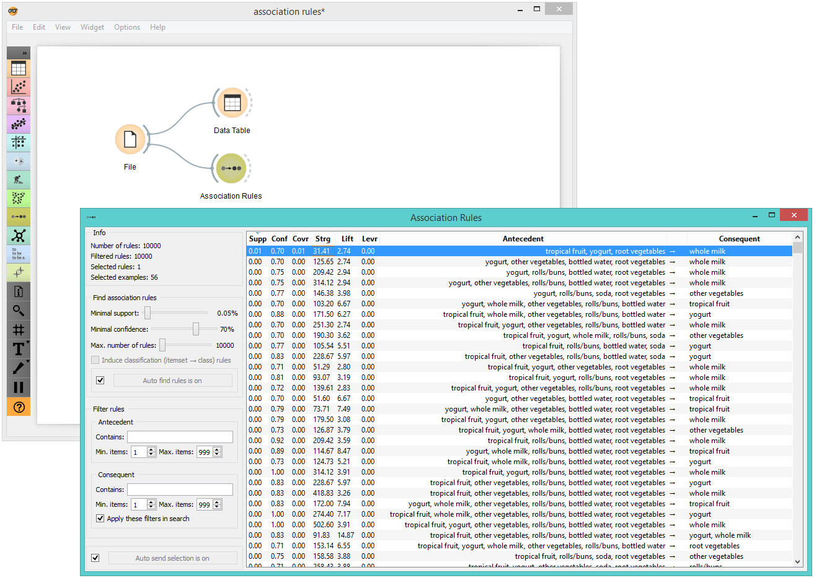
Apriori Rules
https://orangedatamining.com/blog/association-rules-in-orange/
https://orange.biolab.si/docs/latest/reference/rst/Orange.associate.html

Slide 16
Recommender Systems: Content-Based vs Collaborative Filtering
Netflix picture

Slide 17
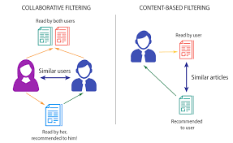
Recommender Systems: Content-Based vs Collaborative Filtering
What are Recommender Systems? Tools that help users discover items (e.g., movies, products) based on their preferences.
Two common approaches are content-based Filtering and Collaborative Filtering.

Slide 18
Content-Based Filtering
Definition: Recommends items based on the content features of items a user has previously liked.
Example: A recommendation system suggesting action movies if you liked similar action films.
How it Works:
Items are described by features (e.g., genre, director, actors).
The system compares these features with items the user has interacted with.
Advantages:
Highly personalised recommendations.
Doesn’t require data from other users.
Disadvantages:
Limited diversity in recommendations (focused on known preferences).
Requires detailed metadata (item attributes).

Slide 19
Example of Content-Based Filtering
Scenario: A user likes action movies with a fast-paced plot.
Movies Watched: Die Hard, Mad Max: Fury Road, The Dark Knight.
System Recommends: John Wick, Mission: Impossible, The Bourne Identity (based on similar action features).

Slide 20
Collaborative Filtering
Definition: Recommends items based on the preferences of other users similar to the target user.
Example: A movie recommendation system suggests films liked by users with similar tastes.
How it Works: User-based: Finds users with similar preferences and recommends items they like.
Item-based: Recommends items similar to ones the user has liked, based on overall user interaction.
Advantages:
Can suggest new items that the user hasn’t seen yet.
Doesn’t require item features—just user interaction data.
Disadvantages:
Requires a large amount of user interaction data.
Cold start problem (new users or items with no interaction data).

Slide 21
Example of Collaborative Filtering
Scenario: User liked Inception and Interstellar.
Other Users' Preferences: Users who liked these films also enjoyed The Prestige, Memento, and Gravity.
System Recommends: The Prestige, Memento, Gravity (based on similar user preferences).

Slide 22
Summary
Aspect | Content-Based Filtering | Collaborative Filtering
Focus | Item features (e.g., genre, director) | User preferences and behavior
Recommendation Basis | Similarity between items | Similarity between users or items
Data Requirement | Item metadata (features) | User interaction data
Advantages | Personalized, no need for other users' data | Can discover new items based on other users' preferences
Disadvantages | Limited diversity, needs item data | Requires large data, cold start problem

Slide 23
Rules
https://towardsdatascience.com/orange-data-mining-tool-and-association-rules-caa3c728613d

